Slide 1




My Solving Equations Interactive Notebook
$$×$$
2x =4
$$÷$$
a-4=7
$$−$$
$$y=17$$
Name
Class
Teacher: Mr Heptinstall
Term 3 Semester 2
x+5=9
2b+7=13
1

Slide 2
Contents
Glossary or Formula Page
Page
Date
Description
2
3

Slide 3

24
7
30
Tasks
24
7
30
Essential Question
Complete the following tasks on this side (left) of your page
Questions
Notes
You should be ticking these off!
Summary
Have YOU been doing your summaries?
Your book, your responsibility!

Slide 4
Let’s start with a game of 25c Pyramid
In pairs, choose one person to be A and one person to be B
Person A will be looking at the board, Person B will look at the back of the room (no peeking!)
A number will be displayed on the screen and you have to get your partner to be the first person to say it but…
Person A can only use the variables, numbers and operations surrounding the number. Nothing else!

Slide 5
For example…
m + 4 = 12
4
=
+
8
6
m
×
÷
12

Slide 6
Person A
w + 3 = 5
4
=
+
2
3
w
÷
×
5

Slide 7
Person B
15 – g = 8
2
=
–
7
8
g
÷
×
15

Slide 8
Person A
6h = 30
4
=
–
5
6
h
+
×
30

Slide 9
Person B
k÷9=2
2
=
–
18
6
k
+
÷
9

Slide 10

24
7
30
Date
Solving Equations
EQ – How do I find an unknown value in an algebraic equation?
From yesterday
To solve an equation with a variable, we rearrange the equation so our unknown value is by itself on one side of the equals sign.
If the variable comes after the operation, be careful! For subtraction and division, we must do more rearranging.
6 – x = 4
+x +x
6 = 4 + x
-4 -4
2 = x
CHECK YOUR ANSWER!!
6 – 2 = 4
If you do something on one side of the equals sign, do it on the other!
What happens if the variable comes second?
Examples
36 ÷ m = 4
× m × m
36 = 4 × m
÷ 4 ÷ 4
9 = m
CHECK YOUR ANSWER!!
36 ÷ 9 = 4
The inverse functions are:
+ -
+
x ÷
÷ x

Slide 11
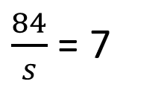
Let’s try some together
a) 7 + d = 24 b) 38 – f = 16 c) 8 × j = -40
d) 63 ÷ q = 9 e) 22 – n = 8 f)
$\frac{84}{s}$ = 7

Slide 12

Do you understand? Fists of Five
Notes:
Check for Understanding

Slide 13
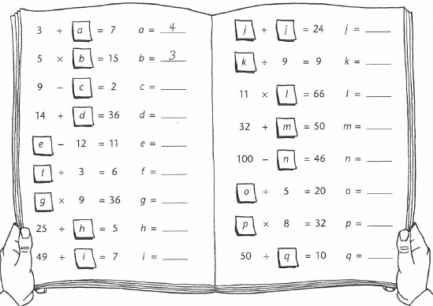
Now your turn!

Slide 14
Notes Review
24, 7 ,30
Date
Title
Essential question
Notes complete
Notes complete with colour and diagrams
Questions completed
Contents page filed in
Formula page filled in

